Slide 1


EventHub
Cloud Academy Capstone Presentation
By:
Aniket LNU
Harsh Agarwal
Nibedita Das
Shreya Srivastava
Kumar Jijnasu
Notes:
JAck

Slide 2









Agenda
1. | Problem Statement | 03
2. | Understanding & Objectives | 03
3 | Analysis and Approach | 04
4. | Technical Implementation | 05
5. | Screenshots | 06
6. | Technical Demo | 11
7. | Final Reflections | 12
8. | References | 13
Notes:
Jack

Slide 3

Project Overview
EventHub
Main Assumption
At the moment, the organization’s events are dispersed across different platform and channels. Event organizers face challenges in effectively promoting and managing their events, while attendees struggle to discover and attend events that align with their interests. There is a need for a centralized platform that brings all events together, providing a user-friendly experience for event organizers to list and promote their events, and offering a comprehensive search and discovery feature for attendees to easily find and attend events of their choice.
Understanding & Objectives
The objective is to create a seamless and efficient event management and discovery experience, enhancing the overall event ecosystem for both organizers and attendees.

Slide 4
Our Approach
Defined project requirements, designed structure and layout of web application.
Built different frontend webpages using React JS and a working backend in Node JS using Express framework with functional API endpoints.
Designed database schema for cosmos DB with MongoDB API and included controller classes in backend for databse operations , integrating Azure service like Blob Storage.
Assembled frontend web pages and integrate with existing API.

Slide 5
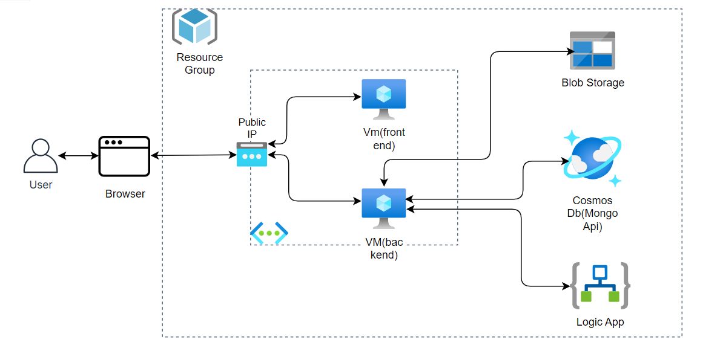
Architecture

Slide 6
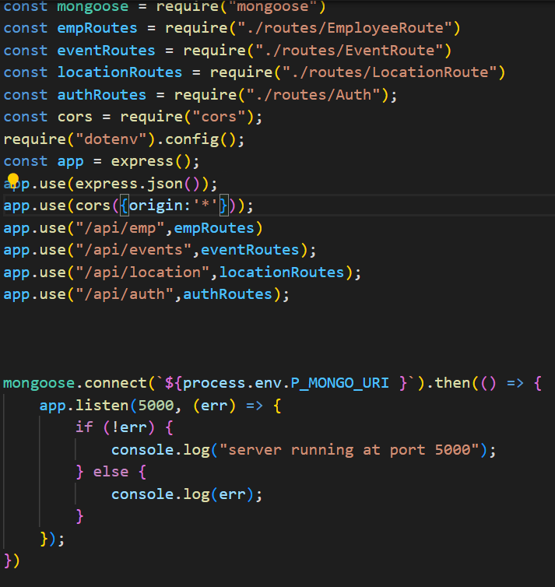
Technical Implementation

Slide 7
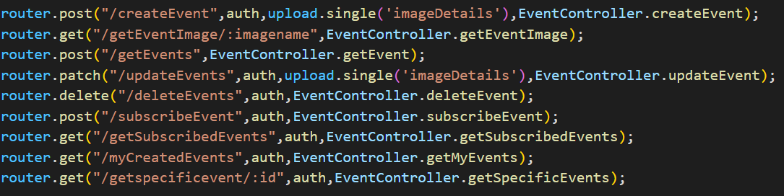
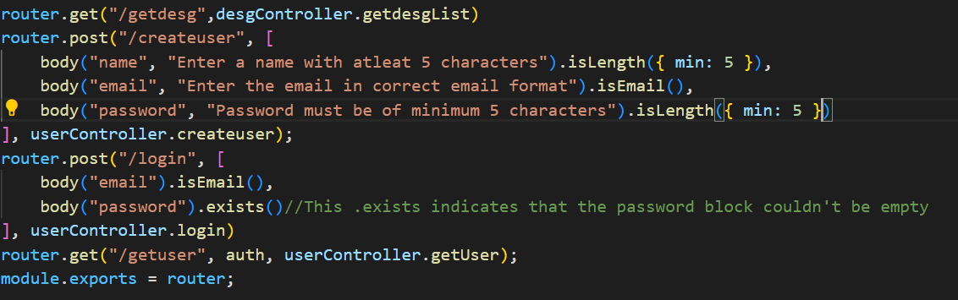

Slide 8
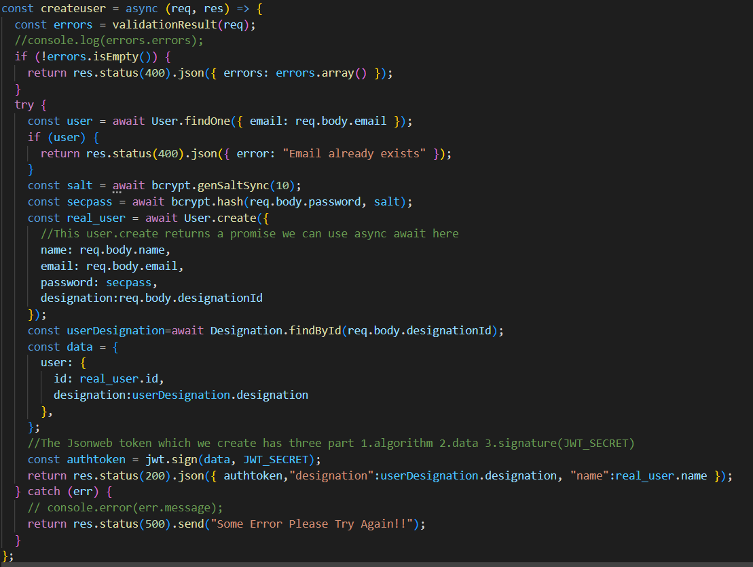

Slide 9
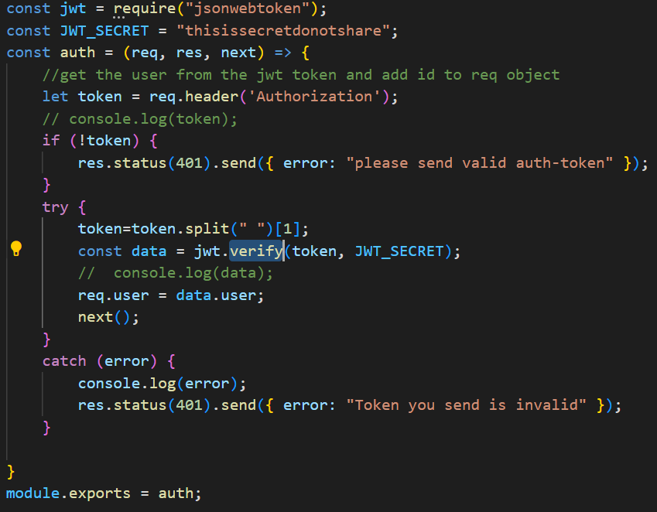

Slide 10
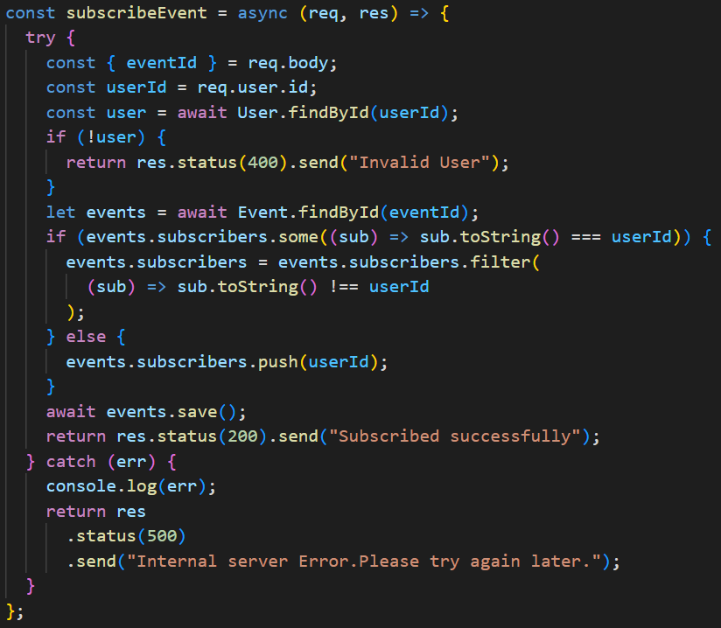

Slide 11
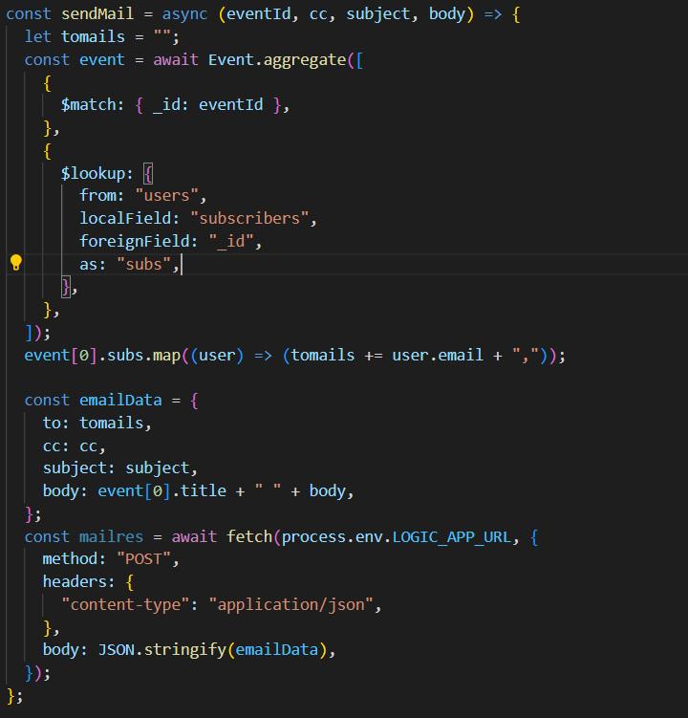

Slide 12
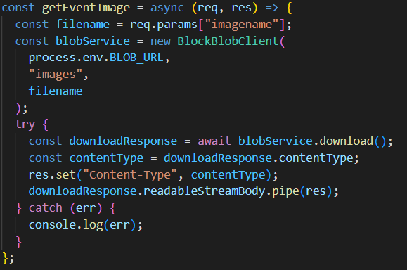


Slide 13
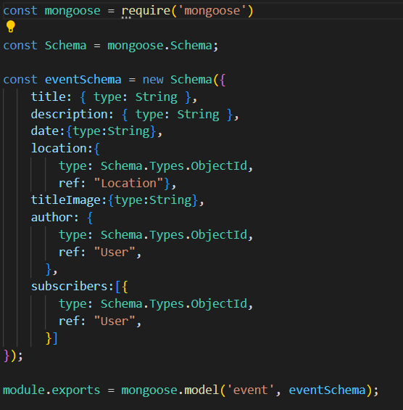
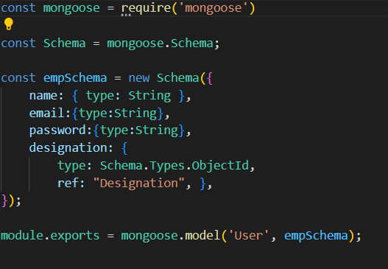

Slide 14
Application Screenshots

Slide 15
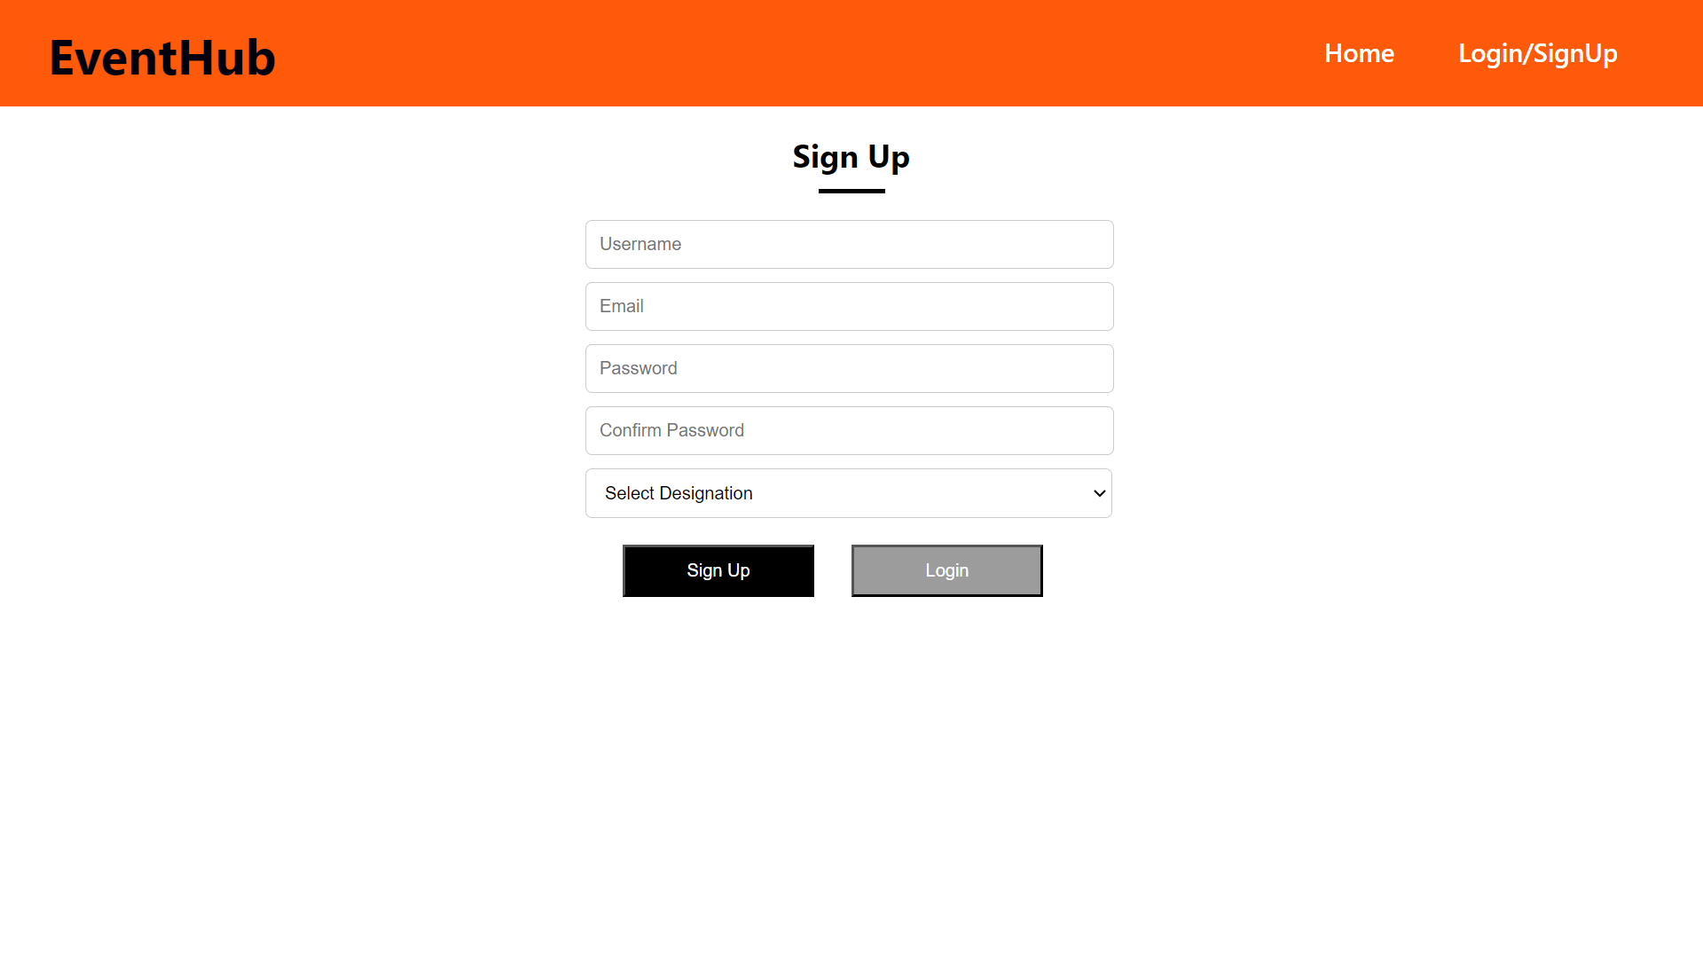
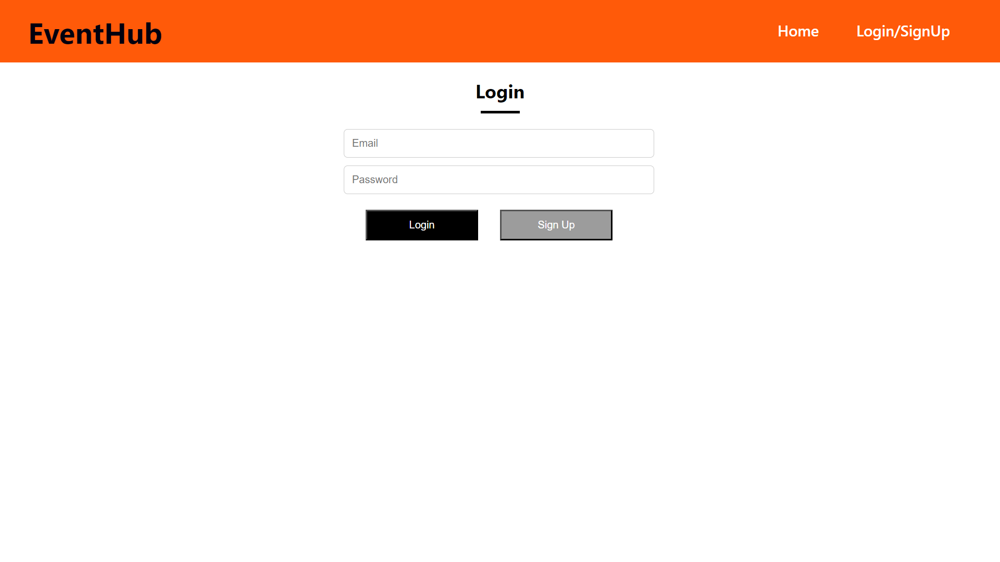

Signup /Login

Slide 16
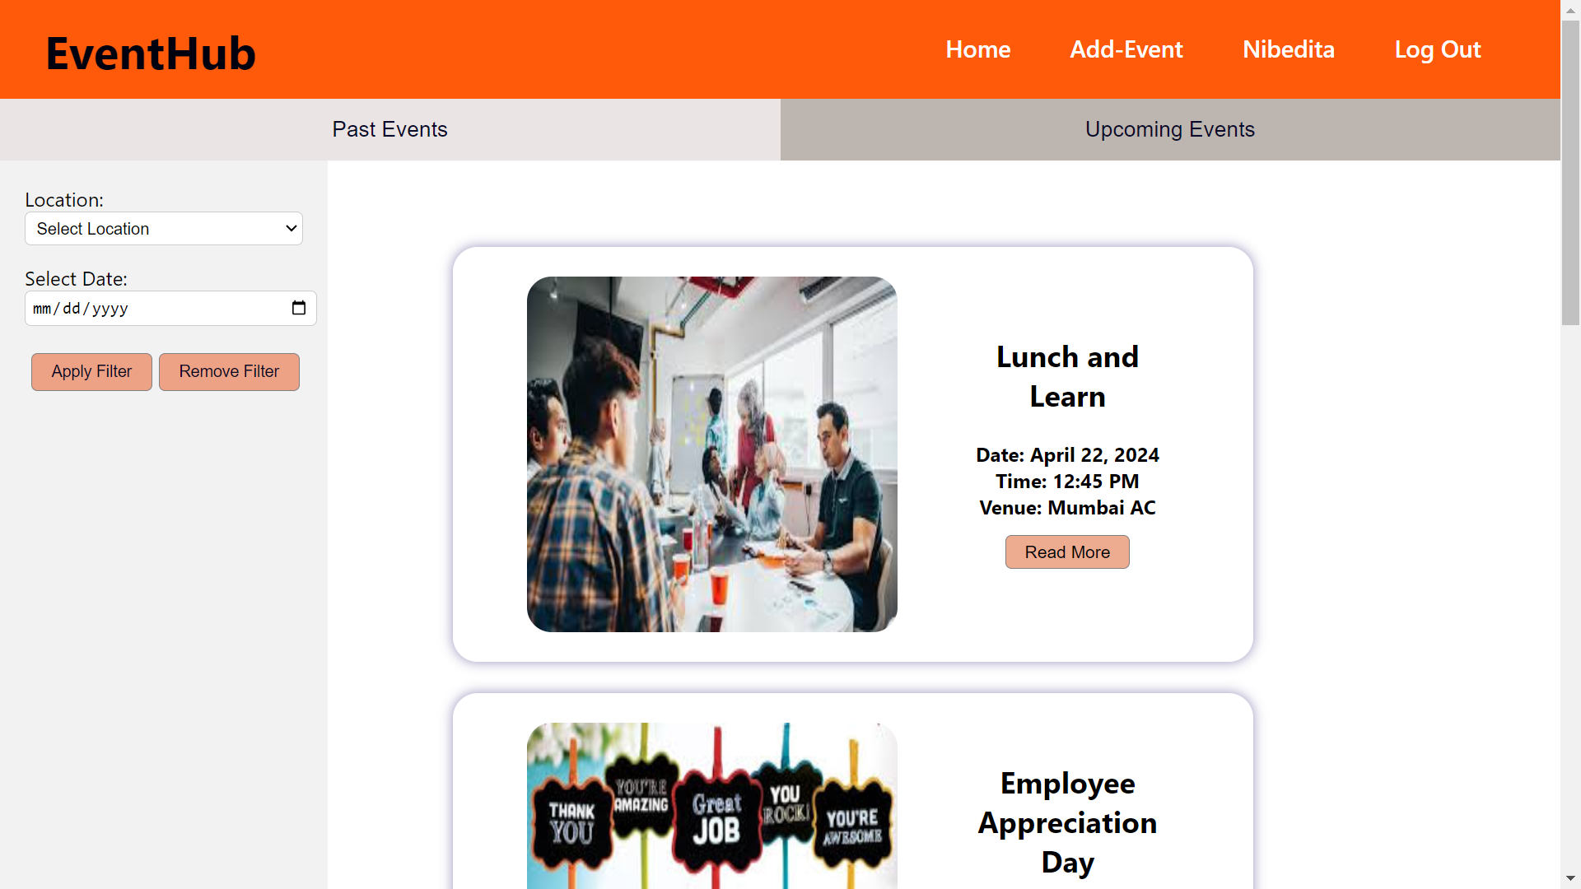



Homepage
HR
Non-HR

Slide 17
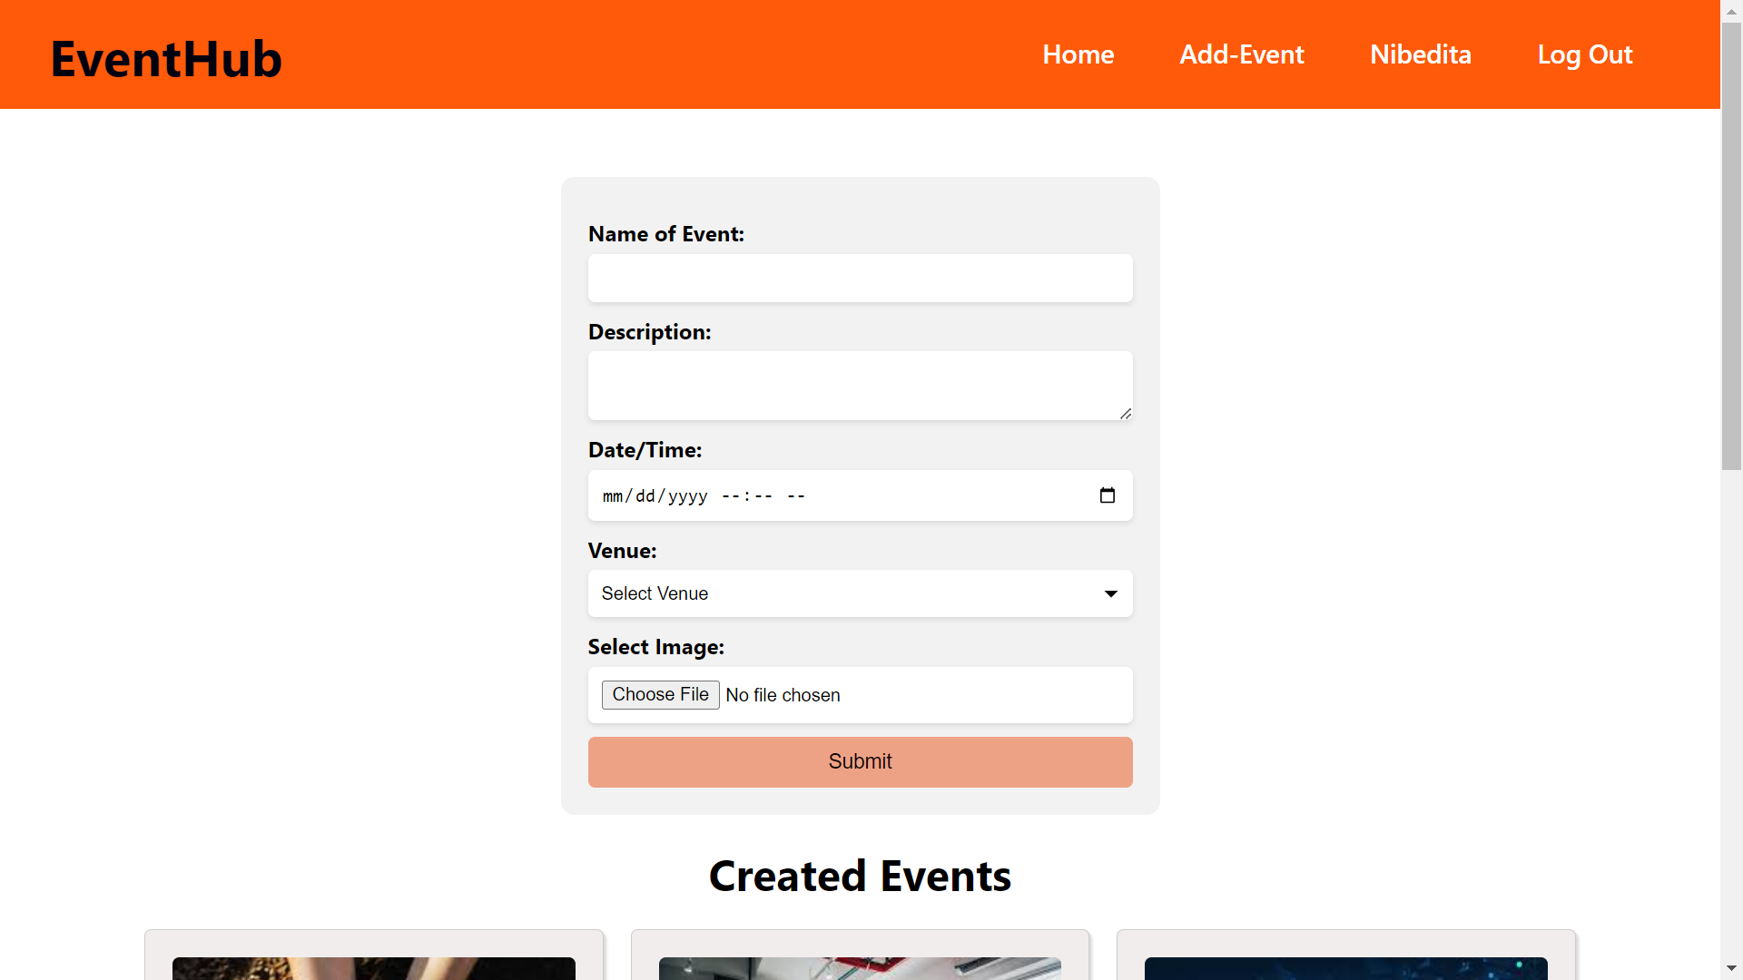
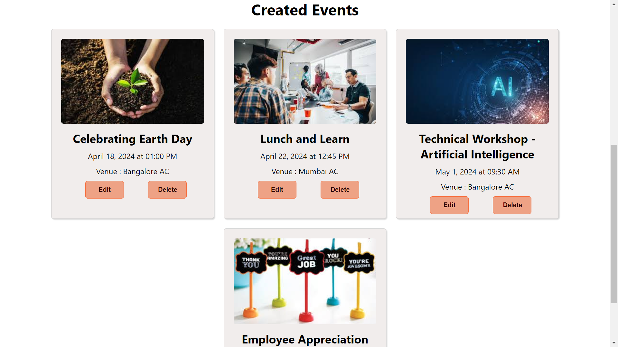
Add-Event page followed by events created by HR

Slide 18
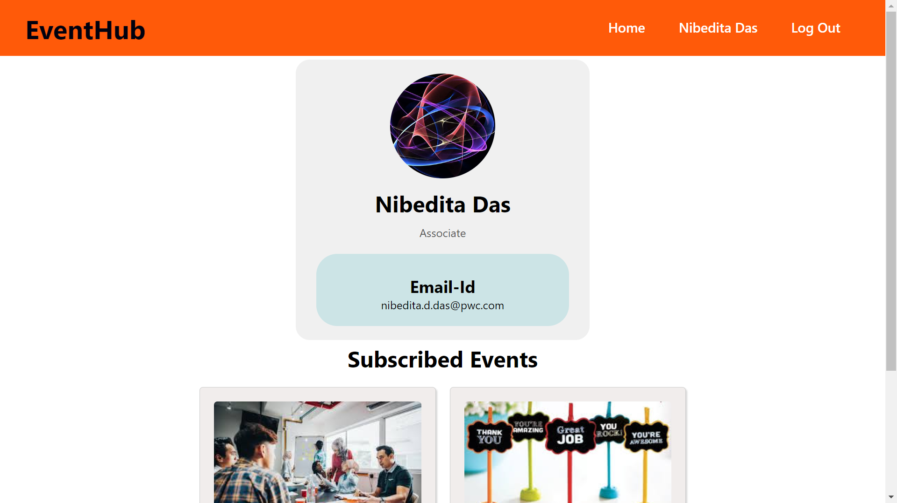
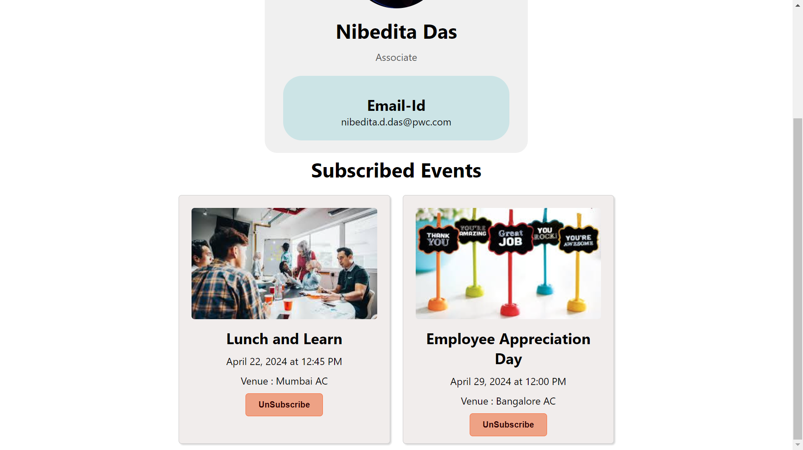
Profile Page followed by Subscribed events

Slide 19
Azure Portal Screenshots

Slide 20
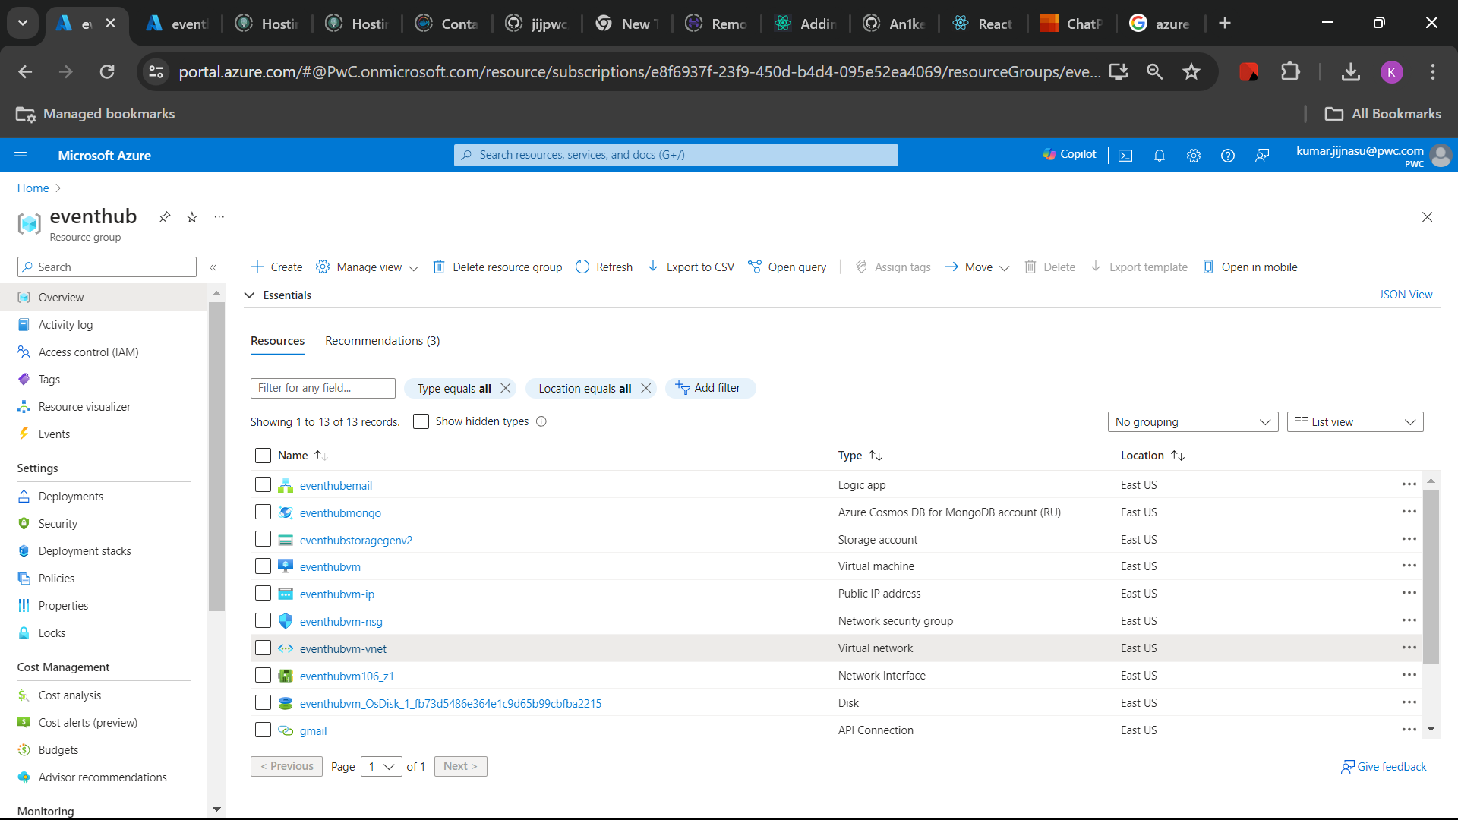
Resource Group

Slide 21
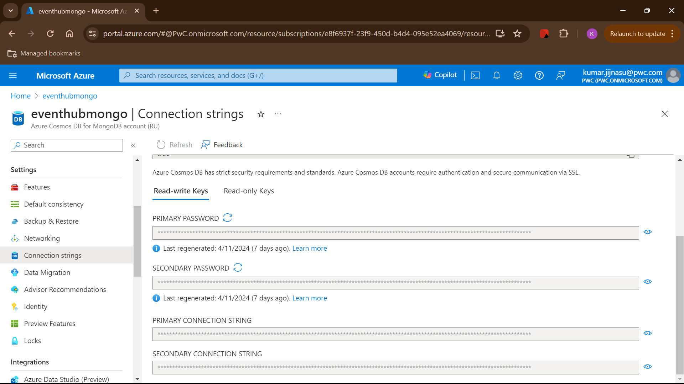
Azure CosmosDB for MongoDB

Slide 22
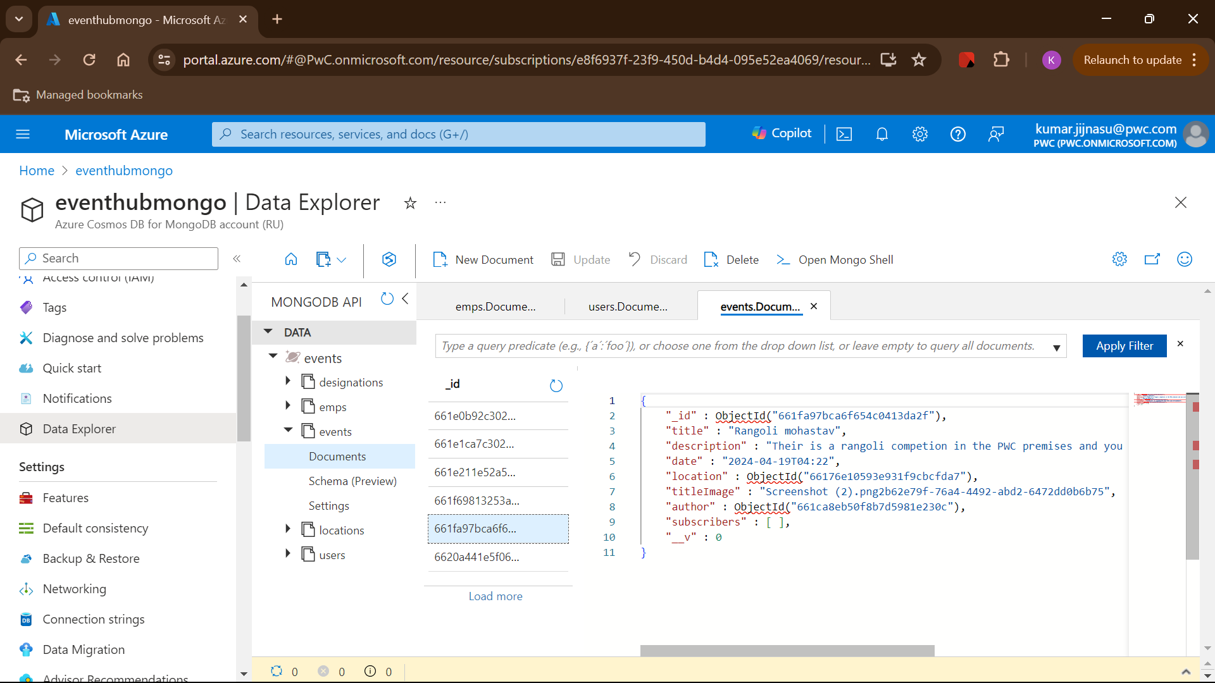

Slide 23
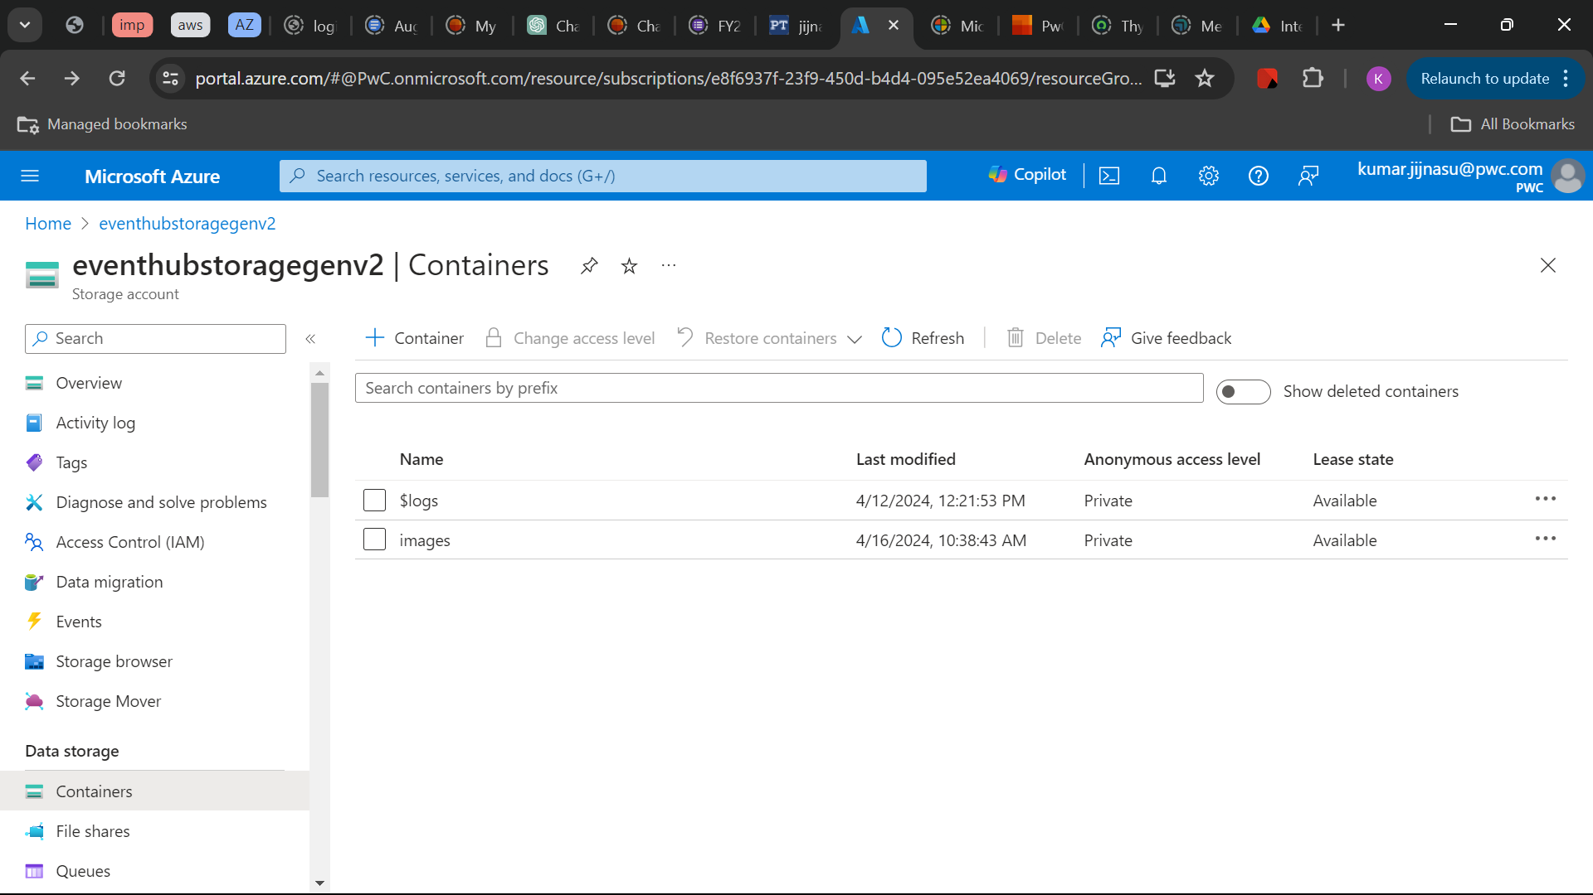
Storage Account-Container

Slide 24
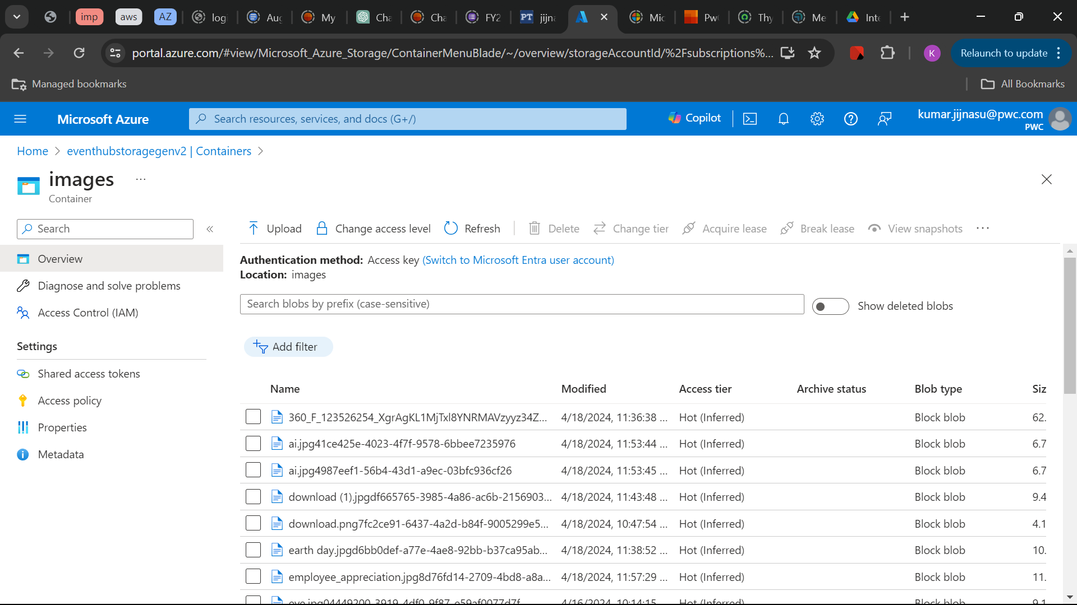

Slide 25
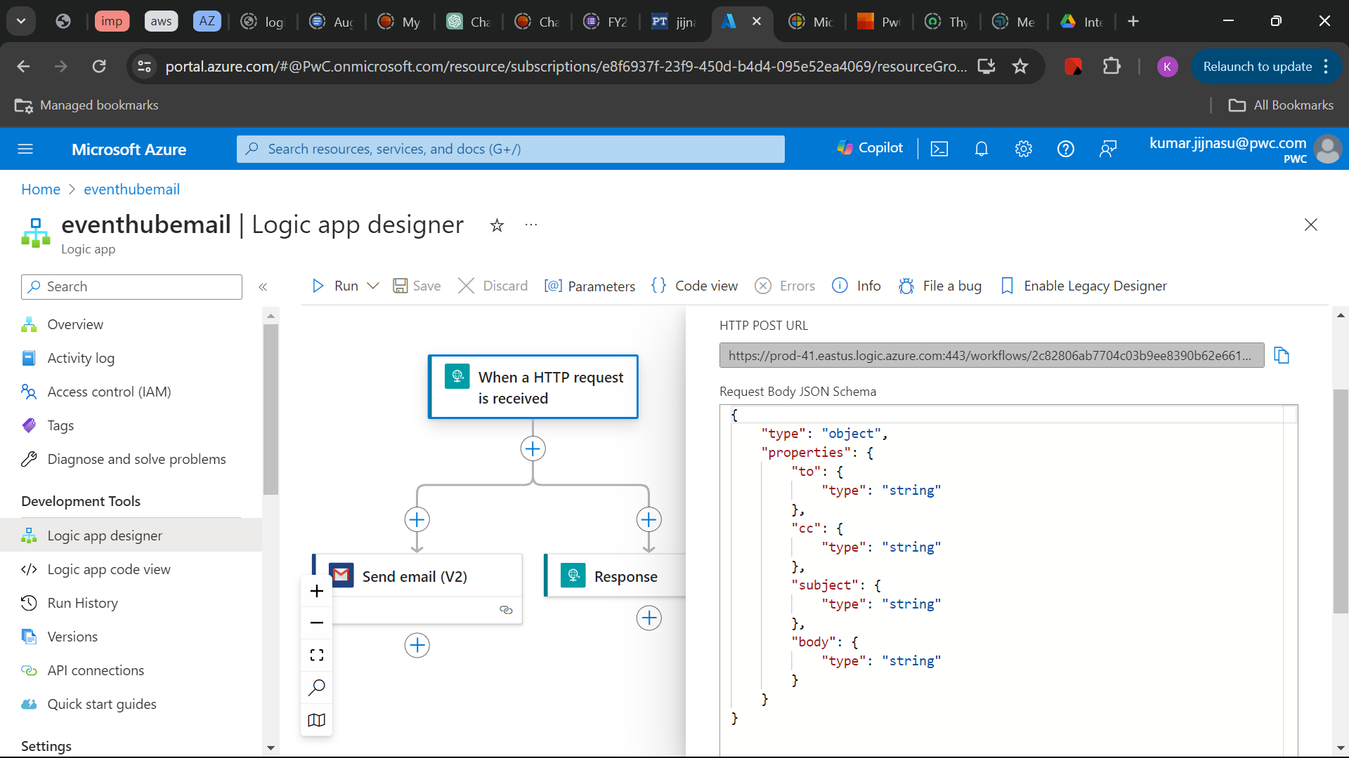
Logic App

Slide 26
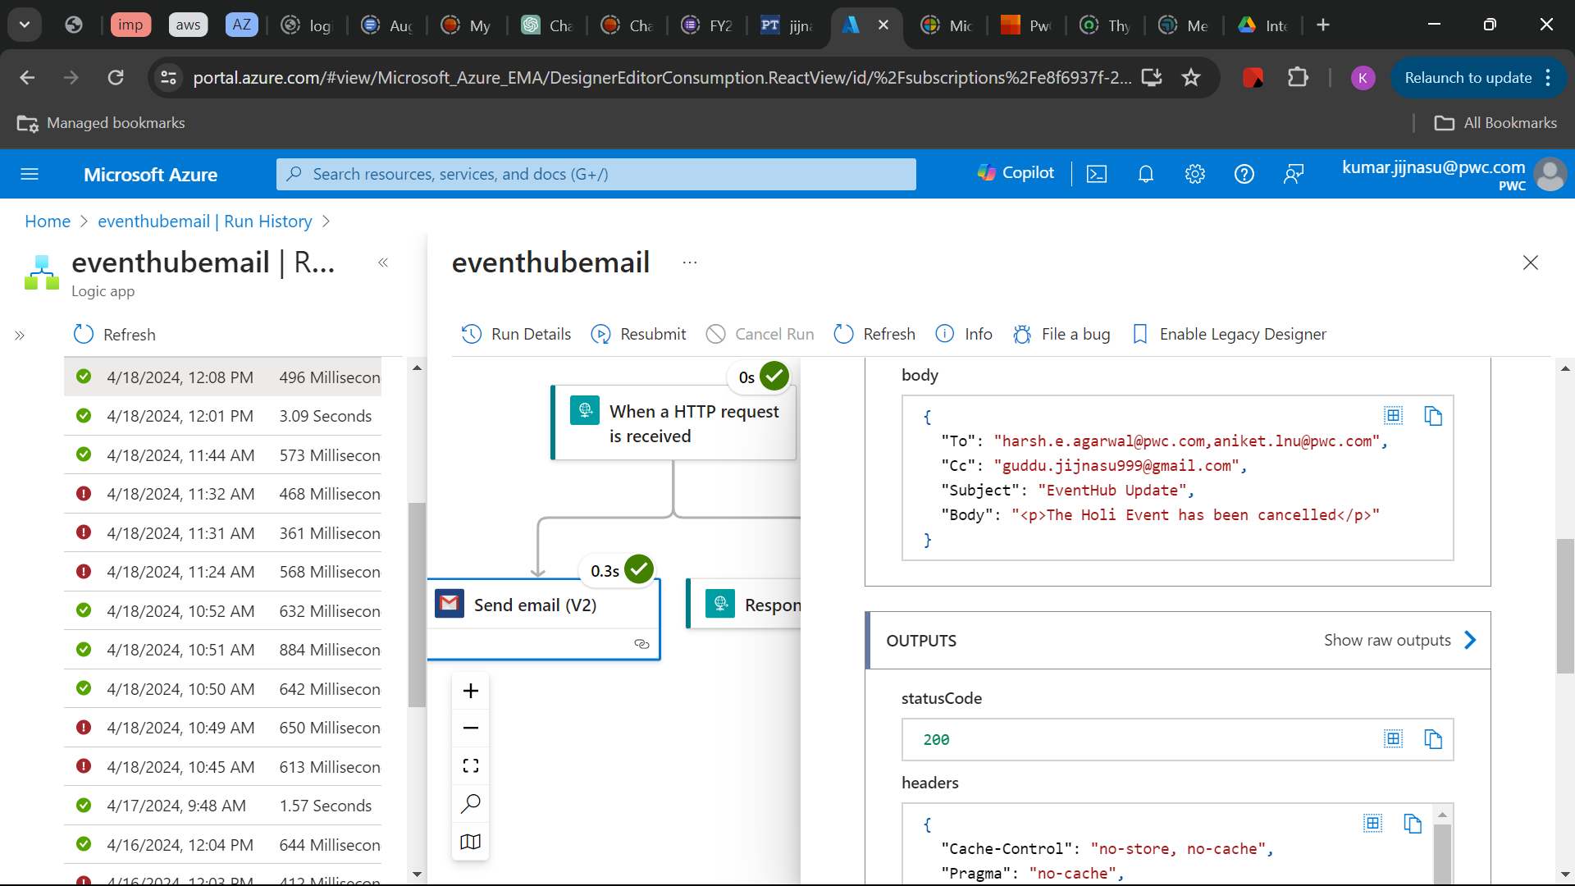

Slide 27
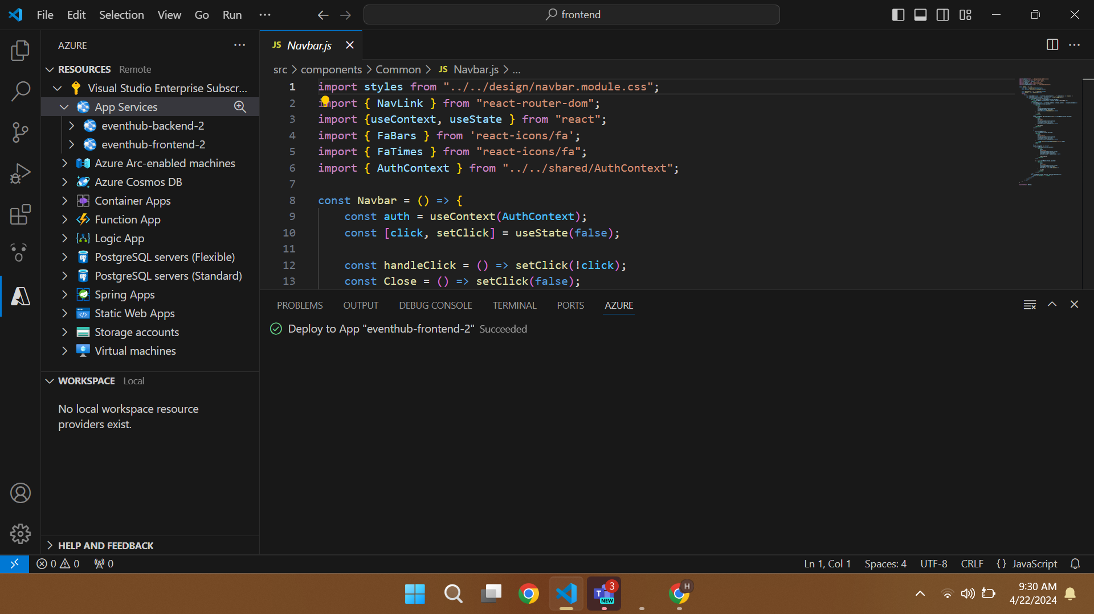
Errors while creating some Services

Slide 28
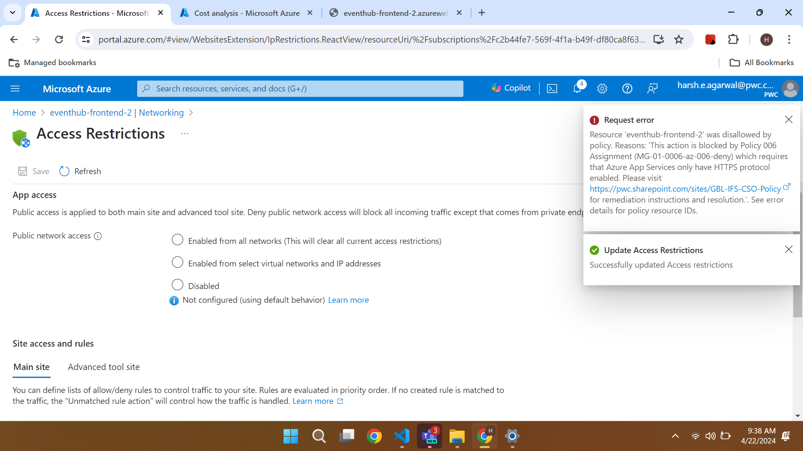

Slide 29
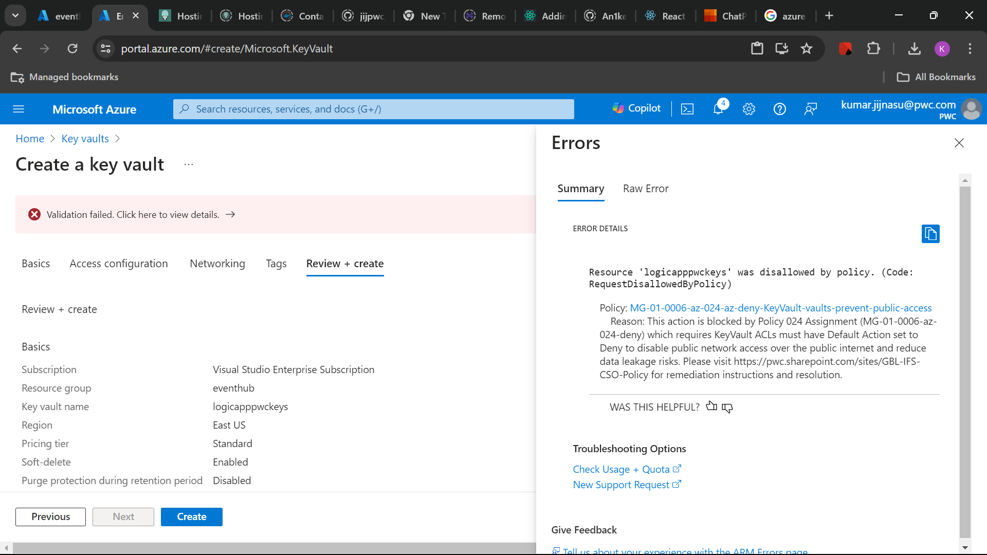

Slide 30

Technical Demo
Patient Registration System

Slide 31
Reflections & Future Extensions
© 2022 PwC. All rights reserved. Not for further distribution without the permission of PwC. “PwC” refers to the network of member firms of PricewaterhouseCoopers International Limited (PwCIL), or, as the context requires, individual member firms of the PwC network. Each member firm is a separate legal entity and does not act as agent of PwCIL or any other member firm. PwCIL does not provide any services to clients. PwCIL is not responsible or liable for the acts or omissions of any of its member firms nor can it control the exercise of their professional judgment or bind them in any way. No member firm is responsible or liable for the acts or omissions of any other member firm nor can it control the exercise of another member firm’s professional judgment or bind another member firm or PwCIL in any way.

Slide 32

References
https://learn.microsoft.com/en-us/credentials/certifications/azure-developer/?practice-assessment-type=certification
https://learn.microsoft.com/en-us/azure/logic-apps/logic-apps-overview
https://learn.microsoft.com/en-us/azure/storage/blobs/
https://learn.microsoft.com/en-us/azure/cosmos-db/
https://learn.microsoft.com/en-us/azure/virtual-machines/

Slide 33
Thank you
pwc.com
© 2022 PwC. All rights reserved. Not for further distribution without the permission of PwC. “PwC” refers to the network of member firms of PricewaterhouseCoopers International Limited (PwCIL), or, as the context requires, individual member firms of the PwC network. Each member firm is a separate legal entity and does not act as agent of PwCIL or any other member firm. PwCIL does not provide any services to clients. PwCIL is not responsible or liable for the acts or omissions of any of its member firms nor can it control the exercise of their professional judgment or bind them in any way. No member firm is responsible or liable for the acts or omissions of any other member firm nor can it control the exercise of another member firm’s professional judgment or bind another member firm or PwCIL in any way.

